Slide 2
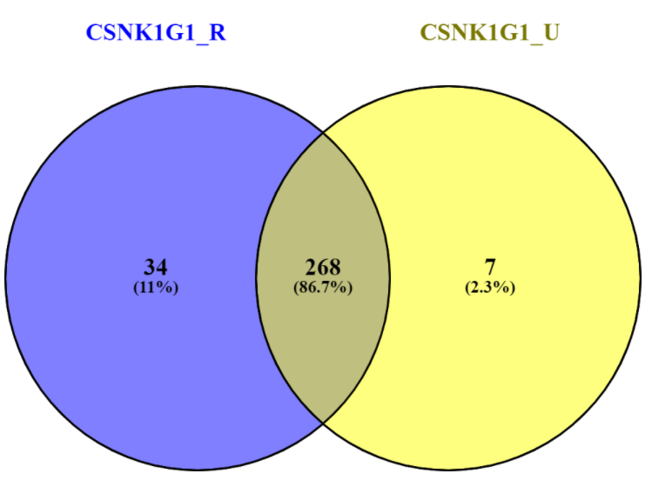
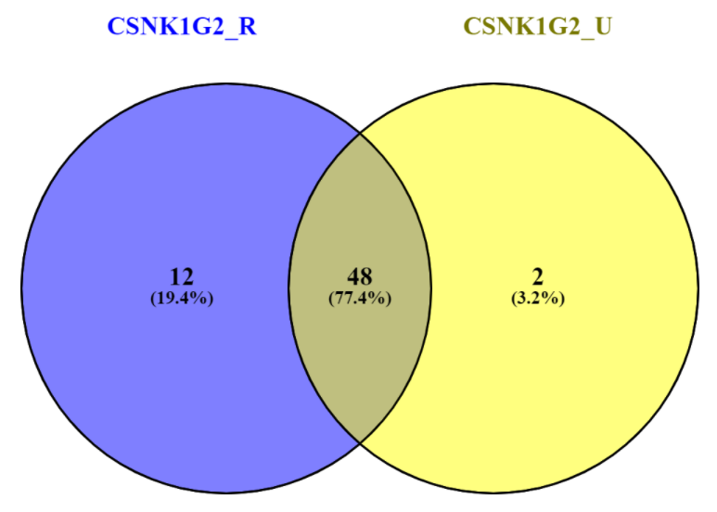
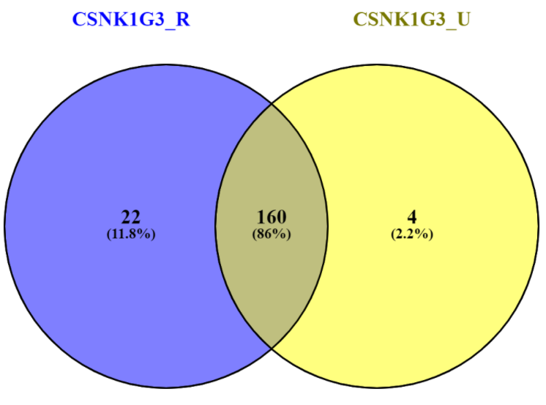
Redone with correct controls
CSNK1G2
CSNK1G3
CSNK1G1
Total: 309
Total: 62
Total: 186

Slide 3
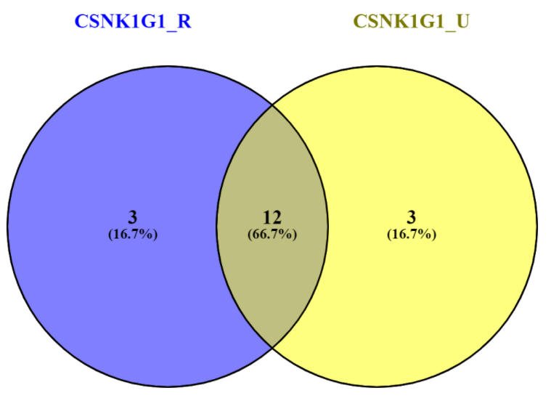
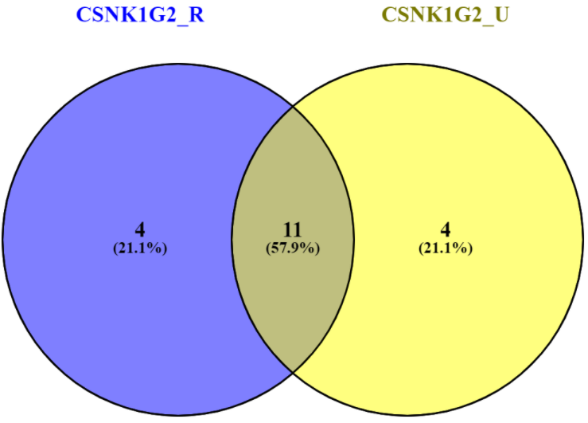

Redone with correct controls
Top 15 by FC
CSNK1G3
DST
MACF1
CSNK1G1
CXADR
SLC12A2
PHACTR4
CELSR2
DLG5
HECTD4
UACA
NEO1
TP53BP2
NECTIN2
CRYBG3
RASAL2
MINK1
NOTCH2
CSNK1G3
DST
MACF1
FAM171A2
CSNK1G2
CXADR
ZDHHC5
NECTIN2
ZDHHC8
NOTCH2
SLC12A2
DLG5
SLITRK5
CELSR2
PHACTR4
MINK1
RASAL2
SEMA4C
OCLN
DST
MACF1
LRIG3
CSNK1G3
CXADR
ZDHHC5
ZDHHC8
FAM171A2
ROBO2
CELSR2
ERBB2
SLC12A2
VANGL2
NECTIN2
RUNDC3B
RASAL2
MINK1
DLG5

Slide 4
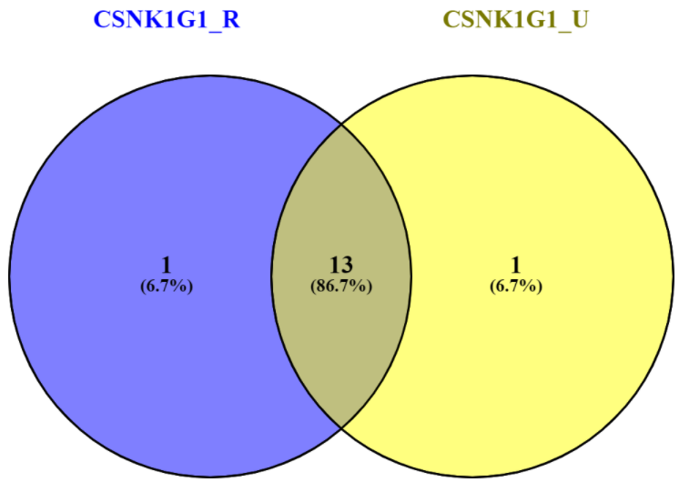
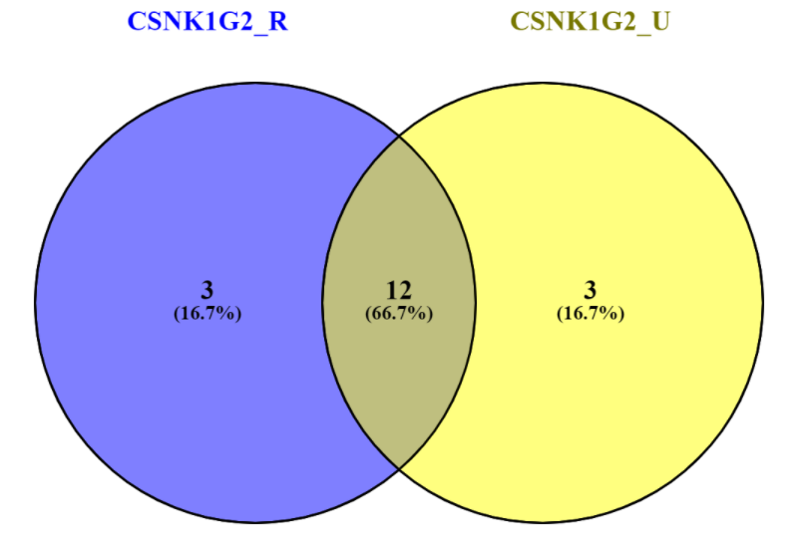
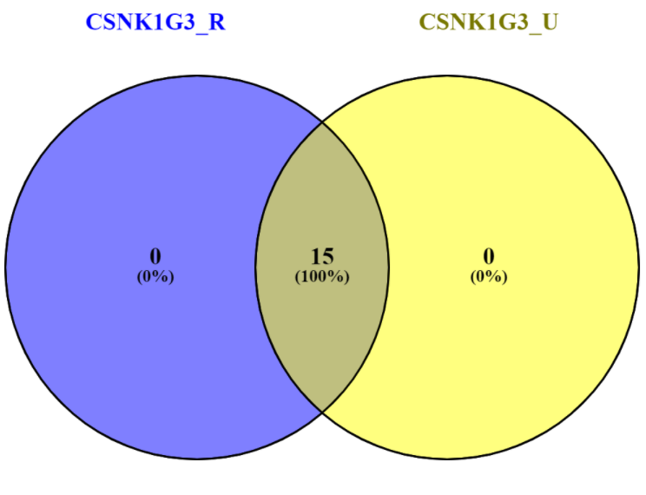
Redone with correct controls
Top 15 by WD
CSNK1G3
TTC7B
RNF19B
RUNDC3B
ADGRA3
PIK3R3
PRICKLE1
CLDND1
CBY1
SBF1
XPR1
VANGL2
GFOD1
KIAA1109
TRIOBP
CSNK1G3
CSNK1G1
FAT1
VIPAS39
HECTD4
WDR13
TTC7B
PIK3R3
RNF19B
PRICKLE1
FIG4
KRIT1
CCDC88C
UACA
GFOD2
CSNK1G3
CDH2
ANKRD26
CSNK1G2
RUNDC3B
CELSR2
TRIOBP
SPTBN2
ARHGAP39
PIK3R2
ZDHHC8
CCDC88A
CTNNB1
DLG5
KIAA1549
RASAL2
IFNGR1
ATP7A

Slide 5
DST
Razor+Unique Peptide quant
Unique Peptide quant
MACF1
Razor+Unique Peptide quant
Unique Peptide quant

Slide 6
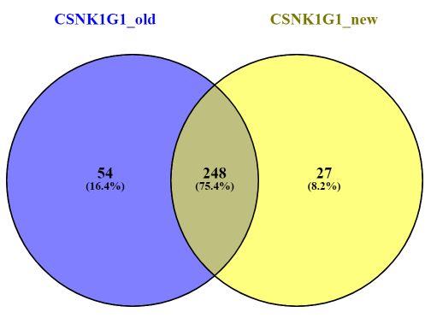
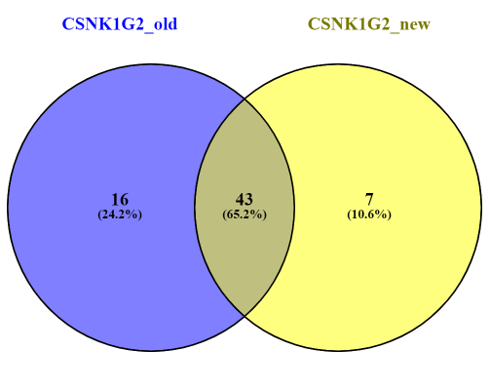

CSNK1G1
CSNK1G2
CSNK1G3
Total: 329
Total: 66
Total: 194

Slide 7
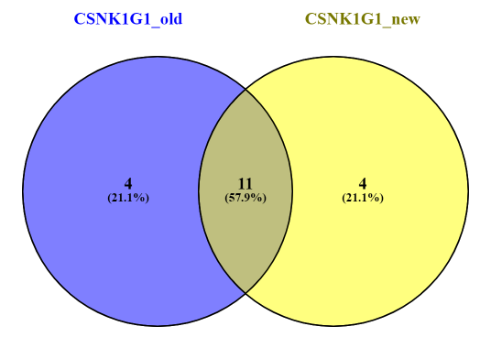
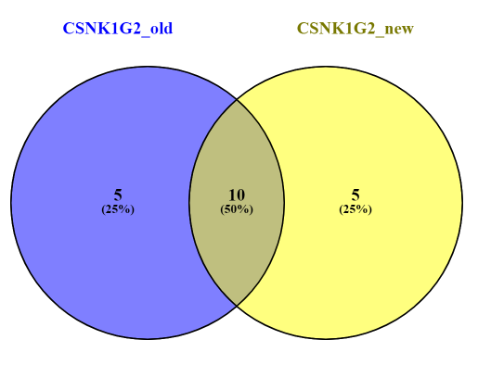

CSNK1G1
Top 15 by FC
CSNK1G2
Top 15 by FC
CSNK1G3
Top 15 by FC
CSNK1G3
RAB11FIP5
SBF1
CCDC8
CSNK1G1
CXADR
SLC12A2
PHACTR4
UACA
DLG5
CELSR2
TP53BP2
NEO1
NECTIN2
CRYBG3
RASAL2
MINK1
HECTD4
NOTCH2
CSNK1G3
RAB11FIP5
IGF2R
FAM171A2
ERBB2
MINK1
RASAL2
NOTCH2
SEMA4C
RUNDC3B
CSNK1G2
CXADR
ZDHHC5
NECTIN2
ZDHHC8
SLC12A2
DLG5
SLITRK5
CELSR2
PHACTR4
RAB11FIP5
SBF1
LRIG3
FARP2
CSNK1G3
ZDHHC5
CXADR
ZDHHC8
FAM171A2
CELSR2
ERBB2
SLC12A2
ROBO2
NECTIN2
VANGL2
RASAL2
MINK1
RUNDC3B
DLG5

Slide 8

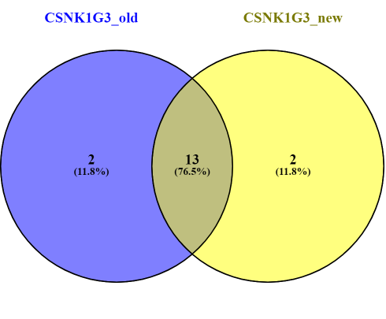
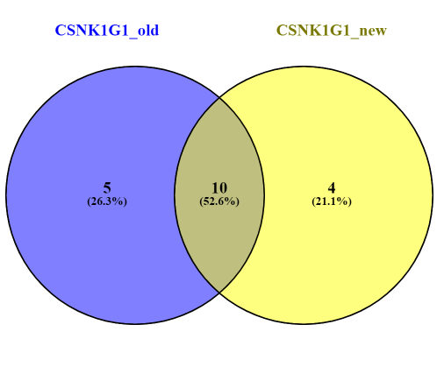
CSNK1G1
Top 15 by WD
CSNK1G2
Top 15 by WD
CSNK1G3
Top 15 by WD
CSNK1G3
CDH2
KIRREL1
ANKRD26
ZDHHC5
SLC4A2
CSNK1G2
CELSR2
SPTBN2
ZDHHC8
ARHGAP39
DLG5
PIK3R2
CTNNB1
CCDC88A
RUNDC3B
TRIOBP
RASAL2
IFNGR1
KIAA1549
ATP7A
AMER1
UACA
CSNK1G3
RUNDC3B
RNF19B
GFOD1
TTC7B
ADGRA3
PIK3R3
PRICKLE1
KIAA1109
CLDND1
XPR1
SBF1
CBY1
VANGL2
TRIOBP
CSNK1G3
ZDHHC14
GFOD1
RUNDC3B
KIAA1109
CSNK1G1
FAT1
WDR13
CCDC88C
HECTD4
TTC7B
UACA
PIK3R3
VIPAS39
KRIT1
RNF19B
PRICKLE1
FIG4
GFOD2

Slide 9
Razor+Unique Peptide quant
Unique Peptide quant

Slide 10
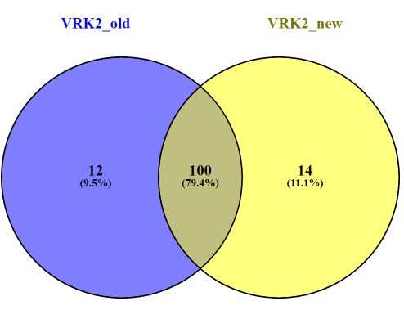
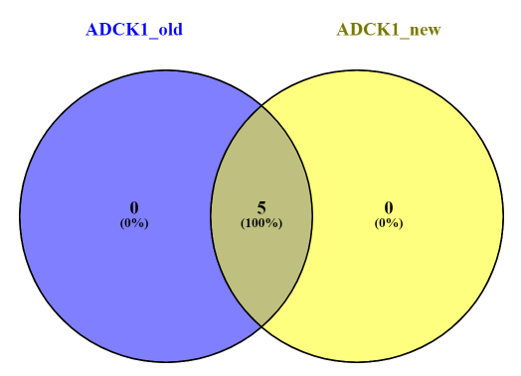
PPP1R15B
ADCK1
NUDCD3
H2AC6
SYTL4

Slide 11
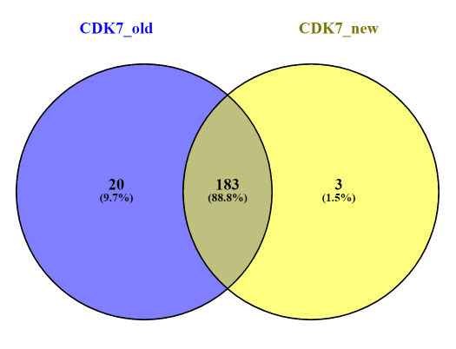
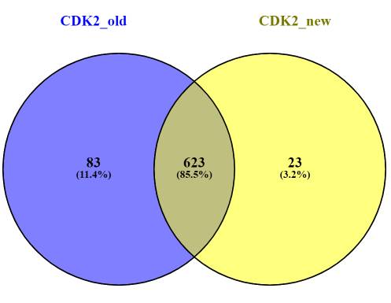

Slide 12
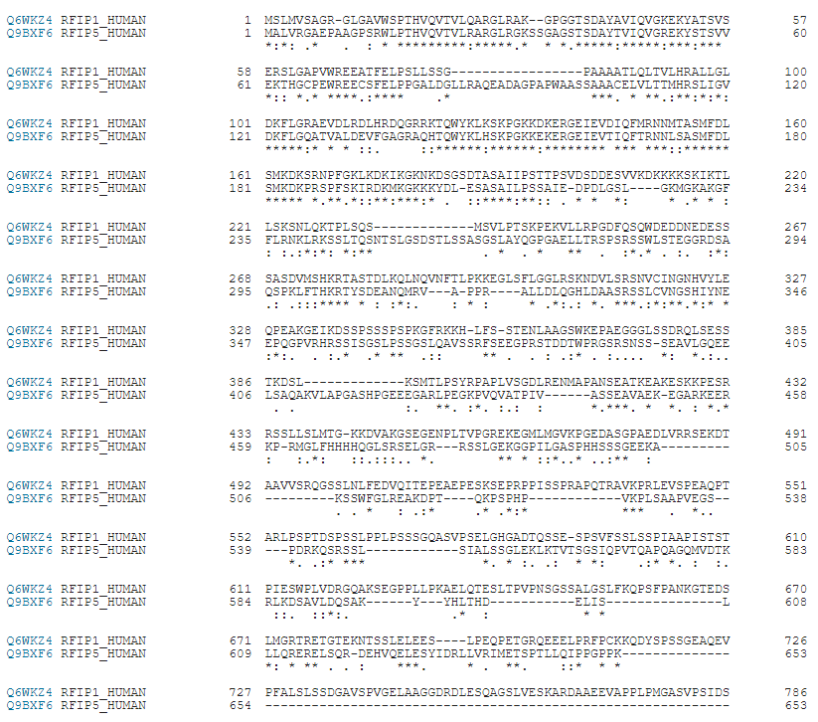
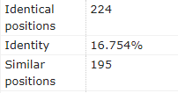
RAB11FIP5 and RAB11FIP1

Slide 13
CSNK1G1
Top 15 by FC
Top 15 by WD
CSNK1G1
CXADR
SLC12A2
PHACTR4
UACA
DLG5
CELSR2
TP53BP2
NEO1
NECTIN2
CRYBG3
CSNK1G1
FAT1
WDR13
CCDC88C
HECTD4
TTC7B
UACA
PIK3R3
VIPAS39
KRIT1
CSNK1G3
RAB11FIP5
SBF1
CCDC8
RASAL2
MINK1
HECTD4
NOTCH2
CSNK1G3
ZDHHC14
GFOD1
RUNDC3B
KIAA1109
RNF19B
PRICKLE1
FIG4
GFOD2

Slide 14
CSNK1G2
Top 15 by FC
Top 15 by WD
CSNK1G2
CXADR
ZDHHC5
NECTIN2
ZDHHC8
SLC12A2
DLG5
SLITRK5
CELSR2
PHACTR4
CSNK1G2
CELSR2
SPTBN2
ZDHHC8
ARHGAP39
DLG5
PIK3R2
CTNNB1
CCDC88A
CSNK1G3
RAB11FIP5
IGF2R
FAM171A2
ERBB2
MINK1
RASAL2
NOTCH2
SEMA4C
RUNDC3B
CSNK1G3
CDH2
KIRREL1
ANKRD26
ZDHHC5
SLC4A2
RUNDC3B
TRIOBP
RASAL2
IFNGR1
KIAA1549
ATP7A

Slide 15
CSNK1G3
Top 15 by FC
Top 15 by WD
CSNK1G3
RUNDC3B
RNF19B
GFOD1
TTC7B
ADGRA3
PIK3R3
PRICKLE1
KIAA1109
CLDND1
XPR1
SBF1
CBY1
CSNK1G3
ZDHHC5
CXADR
ZDHHC8
FAM171A2
CELSR2
ERBB2
SLC12A2
ROBO2
NECTIN2
VANGL2
AMER1
UACA
VANGL2
TRIOBP
RAB11FIP5
SBF1
LRIG3
FARP2
RASAL2
MINK1
RUNDC3B
DLG5

Slide 16
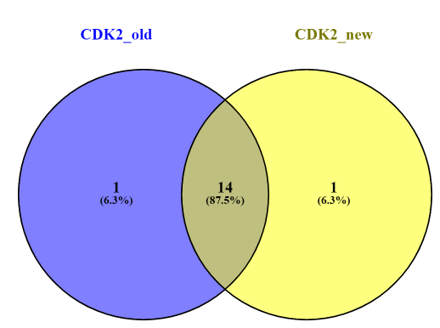
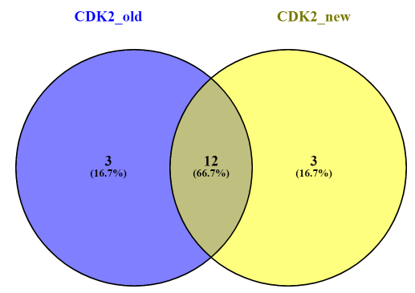
Top 15 by FC
Top 15 by WD
KIF24
CCNB3
CCNH
CCNE2
SKP2
SCAPER
FZR1
RBL2
PLEKHA8
RBL1
CCNA2
SMTNL2
ERCC3
SGO1
RBL1
CDK2
CCNA2
RBL2
ZNHIT6
OFD1
SKP2
NPAT
CEP152
MNAT1
UBR5
NFATC2IP
CREBBP
PRPF8
TICRR
PHF8
ALMS1
USP1
ANAPC4
TICRR

Slide 17
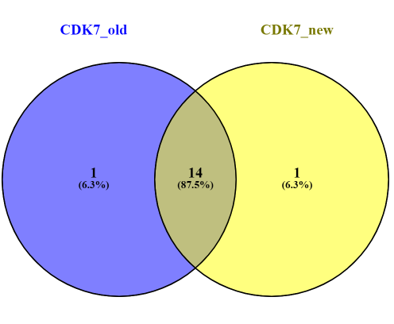

Top 15 by WD
Top 15 by FC
ERCC3
CDK7
MNAT1
CCNH
GTF2H1
UBR5
TAF1
TFIP11
ANLN
YEATS2
GTF2E2
IRF2BP2
KDM3A
CCNA2
CCNH
GTF2H1
ERCC3
MNAT1
CDK7
TAF1
CDK11B
ERCC2
ERCC5
DBR1
GTF2E2
MED26
TET1
AFF4
ZMYND8
PHKG1
GTF3C5
TAF4

Slide 18

Top 15 by WD
TMEM131L
PDE3B
ATF6B
ATP6AP2
TMCC1
MMGT1
EIF2AK3
ATF6
ABCA3
TYW1
NBAS
AMFR
ST7
TAOK2
EMC3
VRK2
SUCO
GRAMD1A

